Slide 1
Development of a Smart Sensing System for Road Performance Data Collection
Victor Guerra, Michael Petersen, Ethan Young, Shlok Singh
Iowa State Program for Sustainable Pavement Engineering & Research (PROSPER)
Dr. Halil Ceylan, Bo Yang, Yueyi Jiao

Slide 2
Project Plan
Ethan

Slide 3
Problem Statement
Iowa DOT tracks road conditions
Priority of road maintenance
Current solutions
Laser rig: expensive, high maintenance
Smartphone apps: proprietary, reliance on expensive hardware
Goal
Cheap hardware & server for data collection & processing
Victor

Slide 4
Project Overview
Road roughness gathering device
Cheap implementation for Iowa DOT
Comply with standard International Roughness Index (IRI)
Hardware
Microcontroller with modules
Black box that sits in a car on the dashboard above a wheel well
Software
Upload raw data, convert to IRI, store, display to user
Ethan
Notes:
Our project was tailored to the Iowa Department of Transportation.
Main emphasis is on the roughness of roads and creating a cheaper device to put in the fleet of vehicles that complies with the IRI standard.
To do this, we used h a microcontroller to place in the vehicles. This is a black box.
Software needs to be able to capture data from the shields on the arduino and integrate the data with the standard. This data will then need to be stored to be able to use later and display to users.

Slide 5
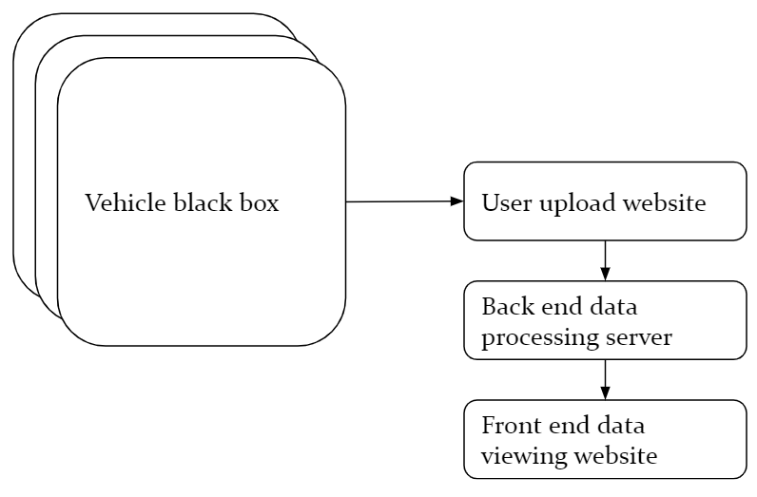
Conceptual Sketch
Ethan

Slide 6
Requirements - Functional
Device should collect accurate data
GPS data
Accelerometer data
On the fly filtering for valid measurement conditions
Central server for large scale data processing
Website file uploading
GSM module
Proper data handling
Server should be able to handle the load
Shlok

Slide 7
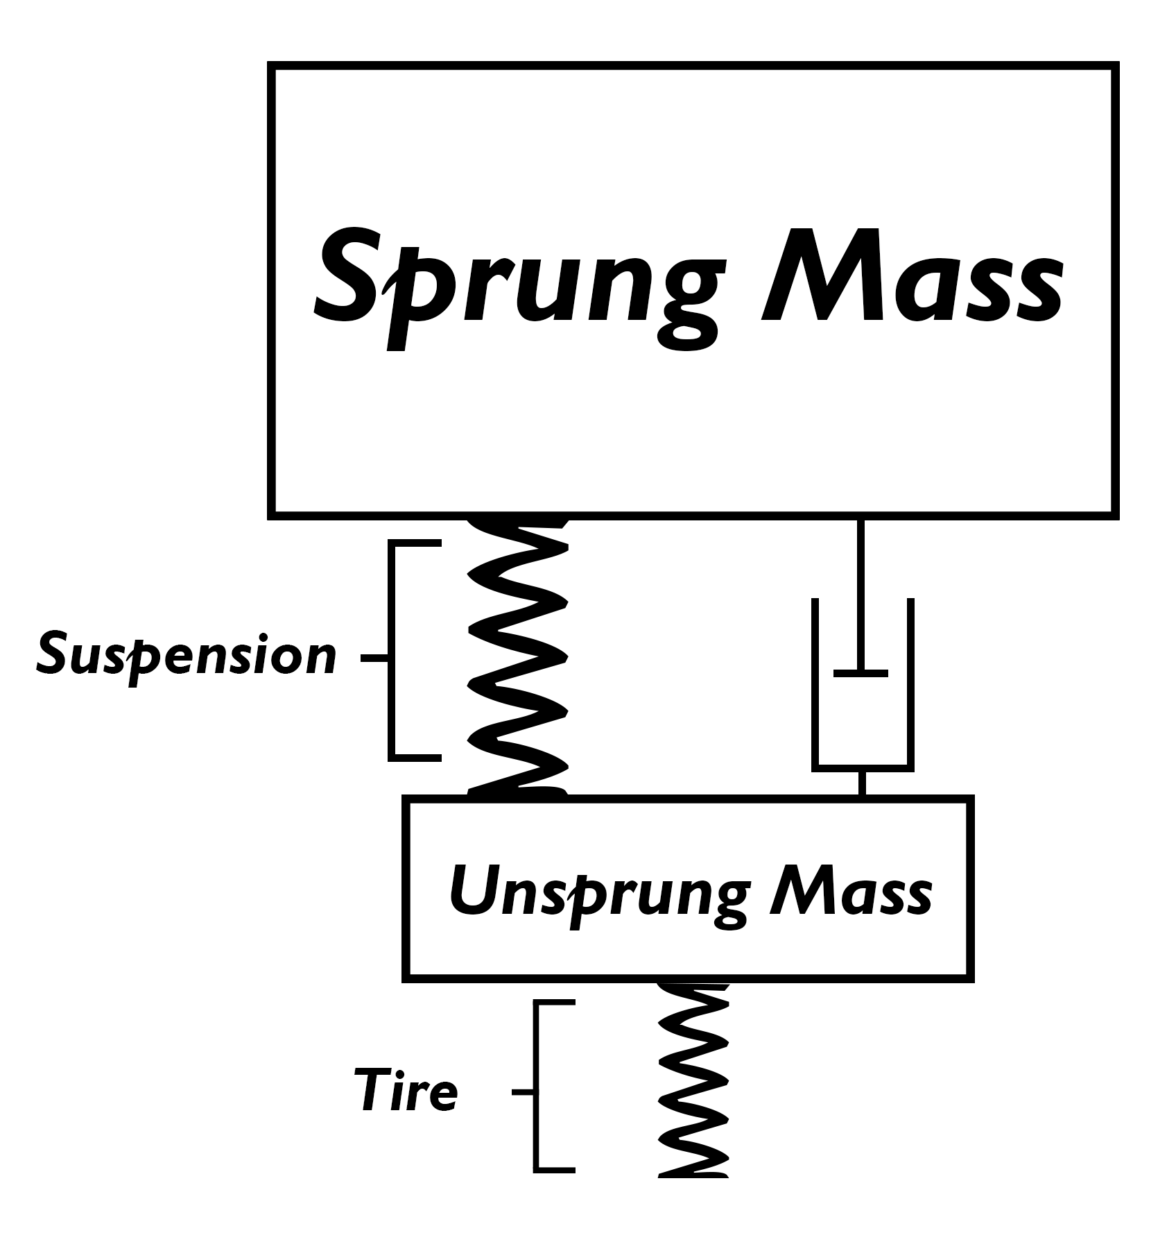
Technical Constraint: Modelling Car
International Roughness Index (IRI)
Widely adopted model
Quarter-car model
Single tire model represents entire system
Compliant to ASTM E1926-08
Golden Car
Ratio of constants estimating typical vehicle
Victor

Slide 8
Risks for Proposed Plan
Technical Risk
Component communication issues
Integration issues with public APIs
Sample write speed to SD card; guarantee samples every 300mm
Acceleration to position noise amplification
Including libraries & embedded code on limited dynamic memory
Consistent sampling for reasonable road profiles (time, speed)
Cost Risk
Scaling cost
Downtime cost/repair
Shlok
Notes:
They dont work together, require the same pins/power
Code is not modular
write speeds slow
Data inaccuracy

Slide 9
Risk Management
Technical Risk
Well-documented hardware components
Scaled down shield libraries to essential functions
Significant experimenting with sample rate consistency
Selective GPS polling for quicker sampling
Filtering methods during data processing
Filtering methods during data collection
Cost Risk
Lightweight scalable back end
Readily available hardware
Shlok

Slide 10
Cost Breakdown
Resource Name | Cost
Arduino Uno | $20.50
Arduino Battery (3.7V 1200mAh) | $9.95
Accelerometer Module (LSM9DS1) | $15.95
SD card module | $4.99
GSM Shield | $49.95
SIM Card + Data Plan | $9.00 + Data plan
GPS & GSM antenna | $2.95
microSD card (8GB) | $6.75
Azure Web Server (IowaDOT can use own servers) | Varies based on devices used -- used student credit for prototyping
Total Device Cost | ~$120
Mike

Slide 11
II. System Design
Ethan
Notes:
Next, we will get into the design of our prototype that we created.

Slide 12
Functional Decomposition
Ethan
Notes:
This is basically how the data flows through the system for the prototype.
Data is captured on the black box and stored to the SD card.
From here, the data is parsed on the server, processed, and sent to the database.
Once in the database, the front-end can get ahold of the stored IRI values and display them for the users.

Slide 13
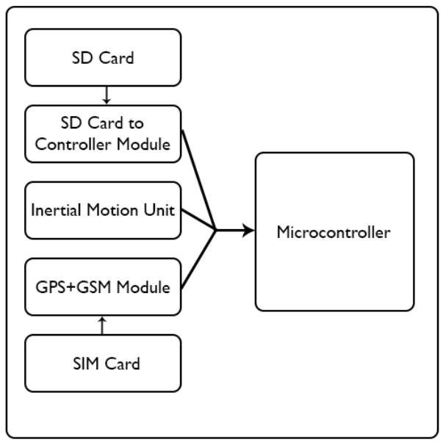
System Design (Arduino)
Arduino Uno
Factors in microcontroller selection
Power Consumption
Pin availability
IO availability
Processing power
Available software libraries
Available memory
Capturing raw data on SD Card
Mike

Slide 14
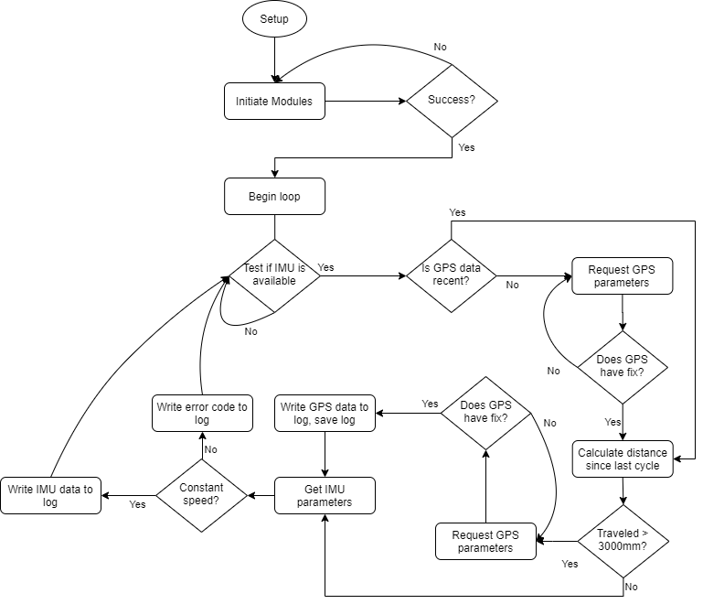
Flow Diagram
Mike

Slide 15
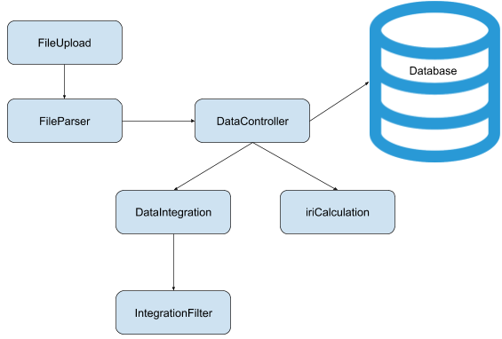
System Design (Back-End)
Azure Web Server running Apache
Node service
MySql database
Javascript Modules
Parsing raw data files
Integration of acceleration values
Trapezoidal Riemann Sums
Filtering due to quadratic error
IRI calculation
ASTM E1926-08 compliance
Ethan
Notes:
The back-end was made to be functional on an Azure Web Server running Apache.
This Azure server included a Node service to control the data and a MySQL database to store the data.
After a file is uploaded, the parser would parse it to a readable format for the data processing.
After parsing, the data is given to the DataController which feeds the integration and the IRI calculation.
The data is first given to the DataIntegration module where it is integrated from accelerometer data to positional profile.
During the integration, we also used a kalman filter to filter the data to reduce noise and quadratic integration error.
The positional profiles then go to the IRI calculation module which gets the IRI value.
The controller then throws this data along with gps coordinates and speed into the database.

Slide 16
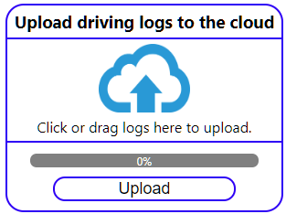
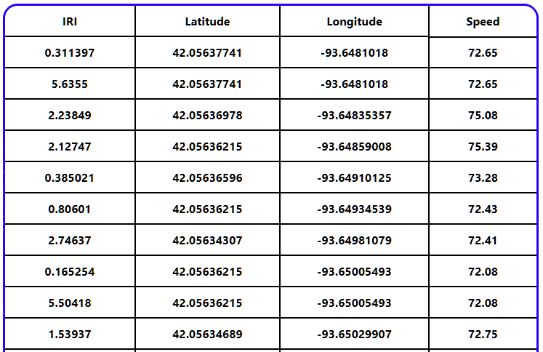
System Design (Front-End)
Front-end file upload
Upload data files from Arduino
Multiple uploads at once
Used React-Files for drag and drop and file search features
Front-end data retrieval
Requests database from Node server
Displays in a table
Ethan
Notes:
The front-end is essential to upload the files from the SD card on the Arduino. It is created in a way to allow for multiple uploads at one time as well.
I used a publicly available component as a dependency for the file selection process called react-files. This just allows to drag and drop files or to click on it and get presented with a file explorer to locate the file.
There is also a table on here that just contains everything that is stored in the database. This data would be mapped out with a map api, but we were unable to achieve this goal in time. It was a stretched goal that we had in the initial planning phase that we were going to get to if we got the main requirement done early.

Slide 17
Test Process
Limited by access to PROSPER equipment
Nothing to compare results with
Accelerometer Z-axis expectations
Centered around 1 g-force
Not logging when travel speeds aren’t constant
Road sample IRI profiles plotted expectations
Roughly 0 slope for average roads
Values ~0<avg<3 smooth roads, ~ <10 rough (speed dependent)
Filtering methods to reduce extreme data points
High speeds => lower IRI values
Victor

Slide 18
Integration Tests
Hardware shields on Arduino
Individually and together
Embedded code on Arduino
Log compatibility with back-end parser
Back-end server
Postman test requests
Front-end upload and data retrieval
Verify operation with back-end
Ethan
Notes:
For the integration testing, we first made sure the hardware would integrate together file. So we tested the shields individually and then all together before we made any soldering decisions.
To make sure that the arduino code would integrate with the backend, we made sure that the files stored on the SD card were compatible with the backend for every change we made.
Postman was also used for the backend to make sure that the API worked as intended and responded with the correct results.
The front-end client was primarily tested to make sure that the data and http requests were working as intended and that there was no loss of data when transering

Slide 19
Testing Challenges
GSM HTTP packets malformed/blank
Sample rate inconsistency
GSM communication establishment time
Accelerometer dynamic positioning
Limited on-board memory
Shlok

Slide 20
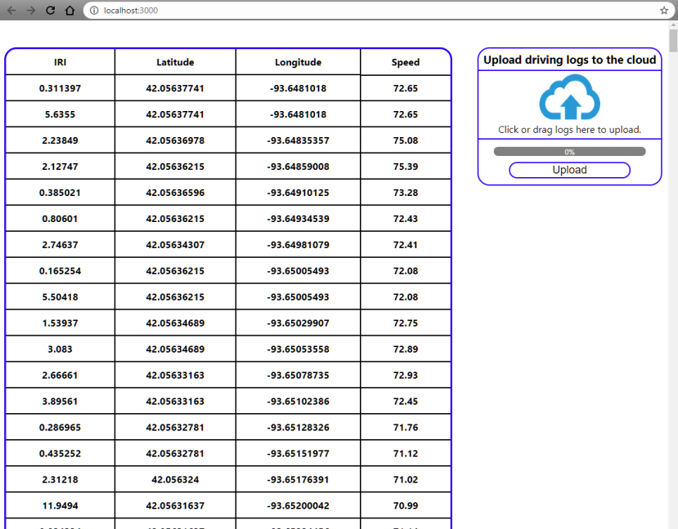
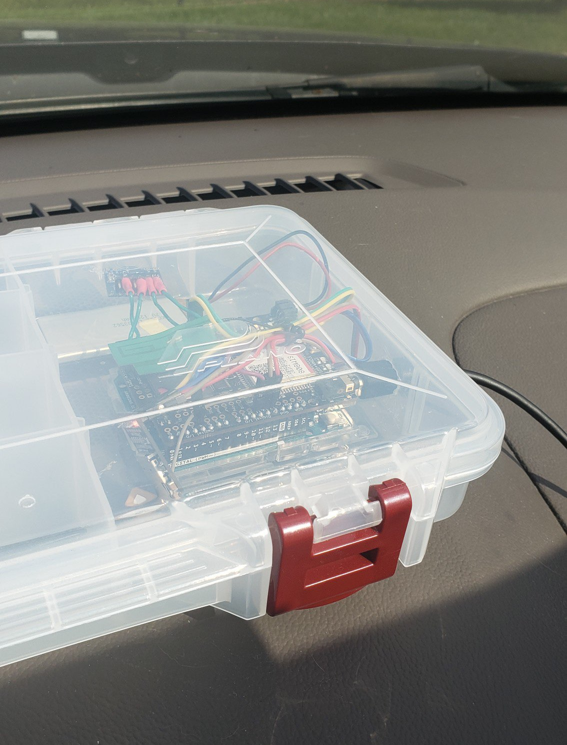
Final Implementation
Victor

Slide 21
Test Results - Accelerometer Data
Accelerating to cruise control @ ~73kph
~3 minute drive @ variable speeds, note noisiness at end
Victor

Slide 22
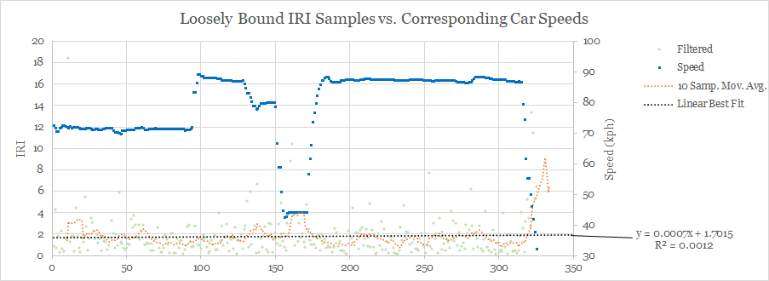
Test Results - IRI Calculation: Loose XY
Victor

Slide 23
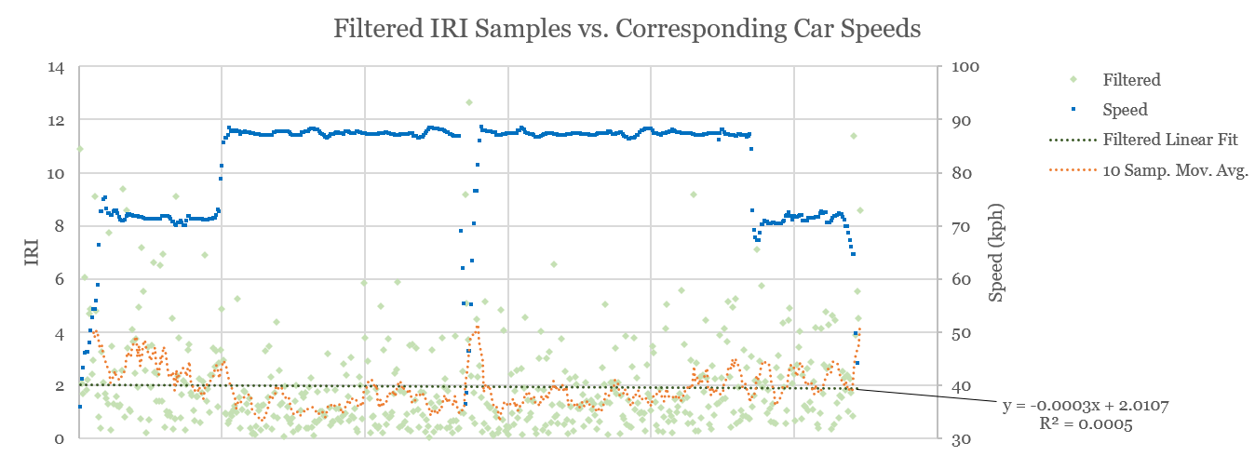
Test Results - IRI Calculation: Final XY
Victor

Slide 24
Engineering Standards and Design Practices
ASTM E1926-08: Standard Practice for Computing International Roughness Index of Roads from Longitudinal Profile Measurements
RFC 2616: Hypertext Transfer Protocol -- HTTP/1.1
ECMA-404: The JSON Data Interchange Syntax
Real-time operating system (RTOS) for small-scale embedded systems
Agile-like environment with Kanban elements for software development process
Mike

Slide 25
III. Conclusions
Ethan
Notes:
Now we will go into some conclusive remarks about the project.

Slide 26
Considerations, Lessons Learned
GPRS is tricky
Failed to build proper HTTP packets, unable to deliver wireless option for raw data transfer
Budget components may lack critical features
Specifically, accelerometer for positional awareness
Budget GPS device with questionable connectivity
2G transfer speed unreliable, future iterations should consider budgeting for 3G or 4G
Filtering parameters (XY, OOB acceptance, filter noise level) need calibration against real world data
Ethan
Notes:
We learned that the gprs was tricky to get going. The body of the http requests were always blank and we could not find another library that was compatible with our hardware.
The budget components may also lack some critical features that we need for more precise calculations. specifically components such as the accelerometer with dynamic collaboration, gps device, and especially the gsm module with only having 2g speeds.
We may also need to tweak many of the filtering parameters that we are currently using such as what is considered out of bounds via the XY acceleration as well as the kalman filter with its noise level. We would definitely need some real world data to test against to make sure that it is accurate.

Slide 27
Contributions
Shlok Singh
Back-end, Networking
Ethan Young
Hardware Setup, Front-end, Back-end
Victor Guerra
Physics, Embedded design, Data processing
Michael Petersen
Embedded design, Testing
Mike

Slide 28
References
http://onlinepubs.trb.org/Onlinepubs/trr/1989/1215/1215-018.pdf
https://www.hindawi.com/journals/mpe/2014/928980/
https://www.sparkfun.com/pages/accel_gyro_guide
https://media.ford.com/content/dam/fordmedia/Europe/en/2016/02/worst_potholes_EU_7.pdf

Slide 29
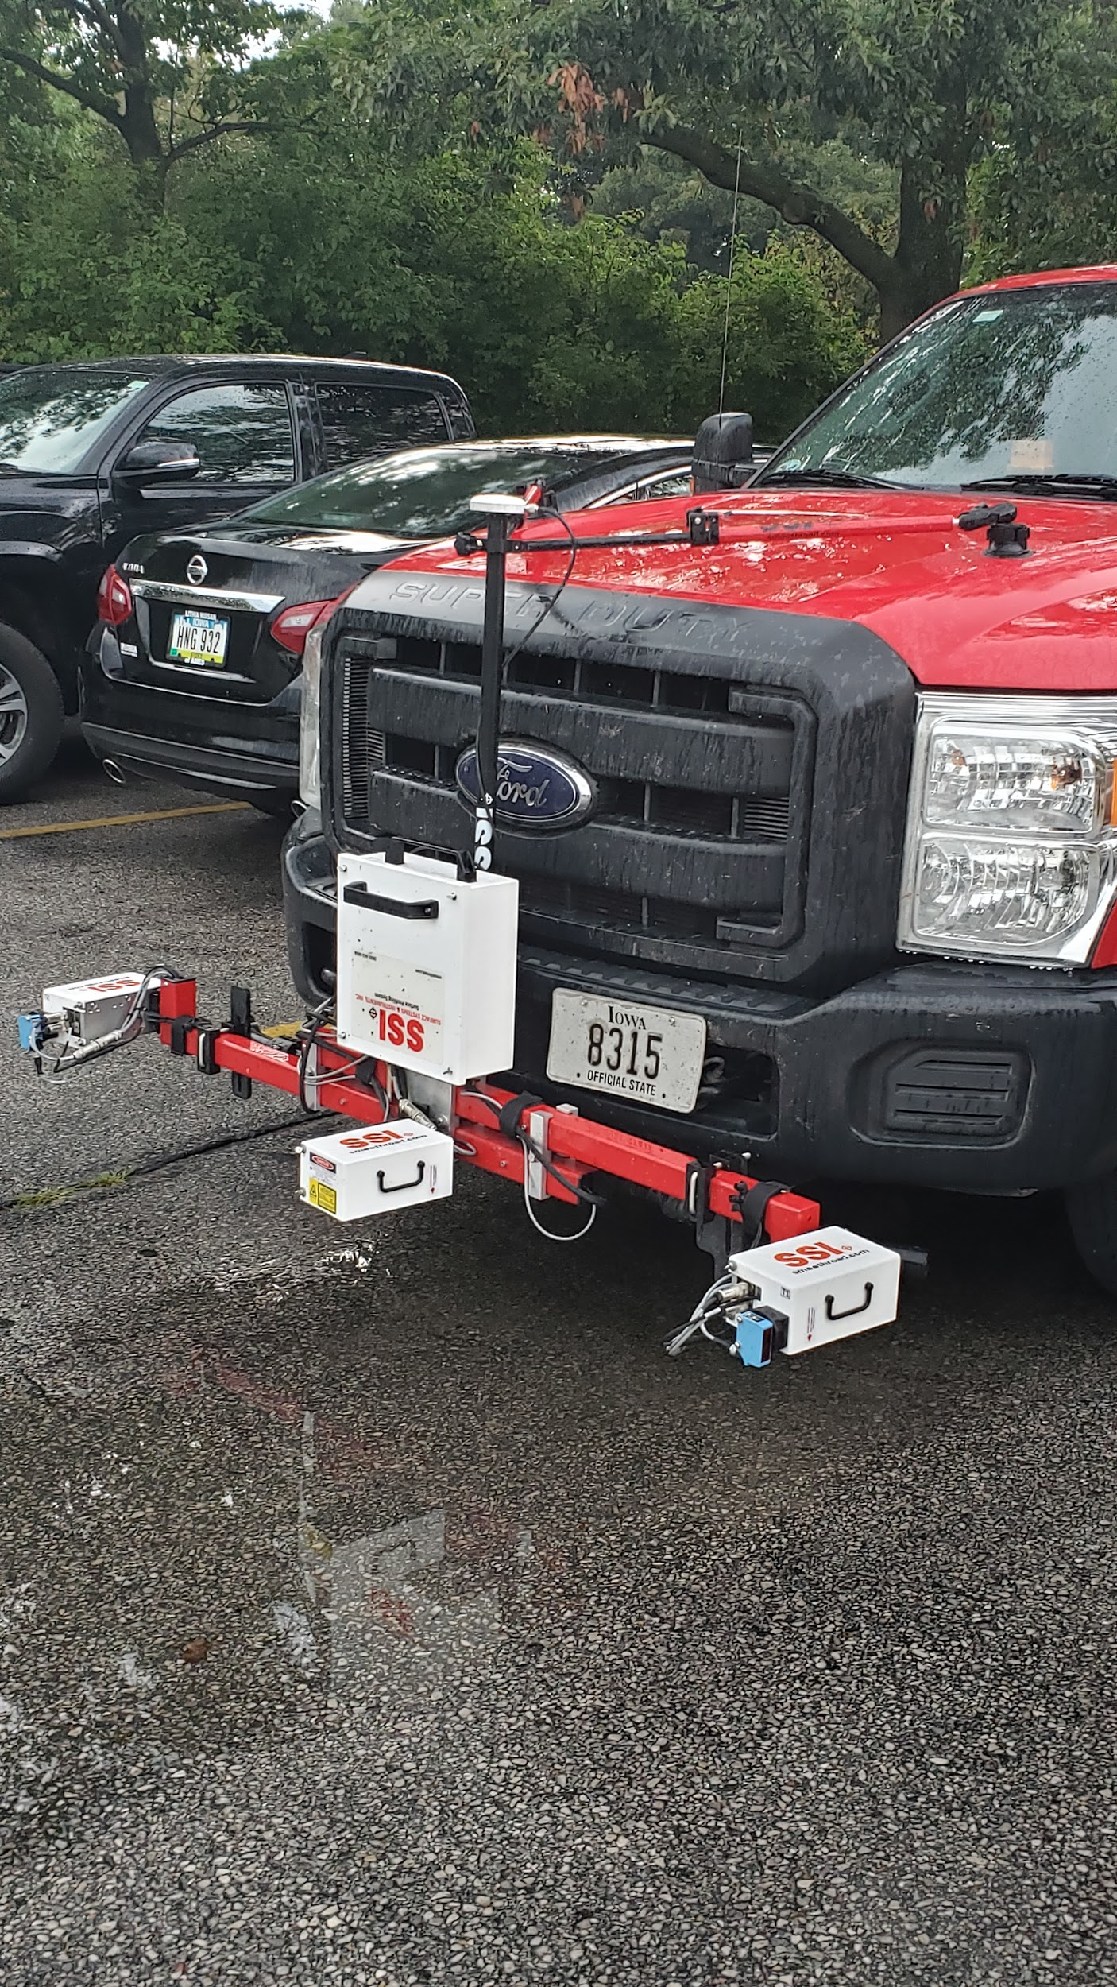
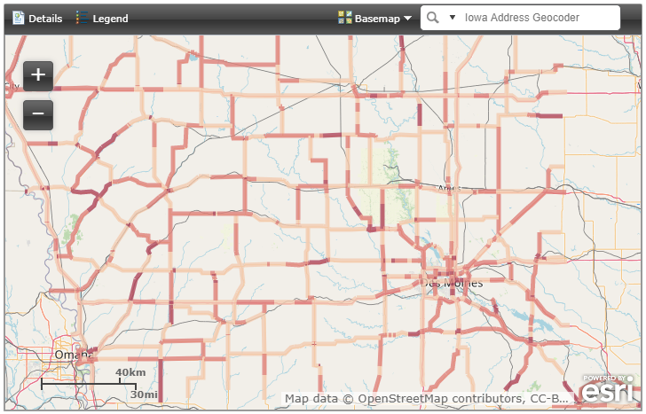
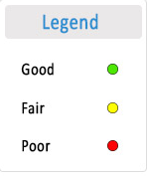
Market Survey
Current Iowa DoT data collection : High Cost - High Accuracy

Slide 30
Conceptual Need
Target clientele: Iowa DOT maintenance analysts
Affordability
Reliability
Standardized roughness model
Scalable

Slide 31
Project Deliverables
Data gathering on Arduino
Accelerometer, speed, GPS, time
Data storing on Arduino
SD Shield
Uploading data containence to cloud server
Web client to database
Displaying data on front-end web client
React website

Slide 32
Requirements - Non-Functional
Reasonable cost (~$100)
Minimal user interaction
Weather resistance
Rugged design

Slide 33
System Design Overview
Black Box enclosure
Microcontroller
Accelerometer
GPS
Removable storage
GSM
Data server
Web client application

Slide 34
Test Process
System Tests:
Plotting final IRI measurement vs. related parameters
Module and Component testing
Individual, integrating multiple together
Local machine
HTTP requests & handling efforts
Postman
Unit Tests:
ASTM E1926-08 compliance sample data for profile to IRI
Javascript module testing

Slide 35
Challenge Solutions & Failures
Technical Challenges
Smaller than desired sample sizes, still allows calculation
Device not suited for hilly areas
Library customization to save memory space

Slide 36
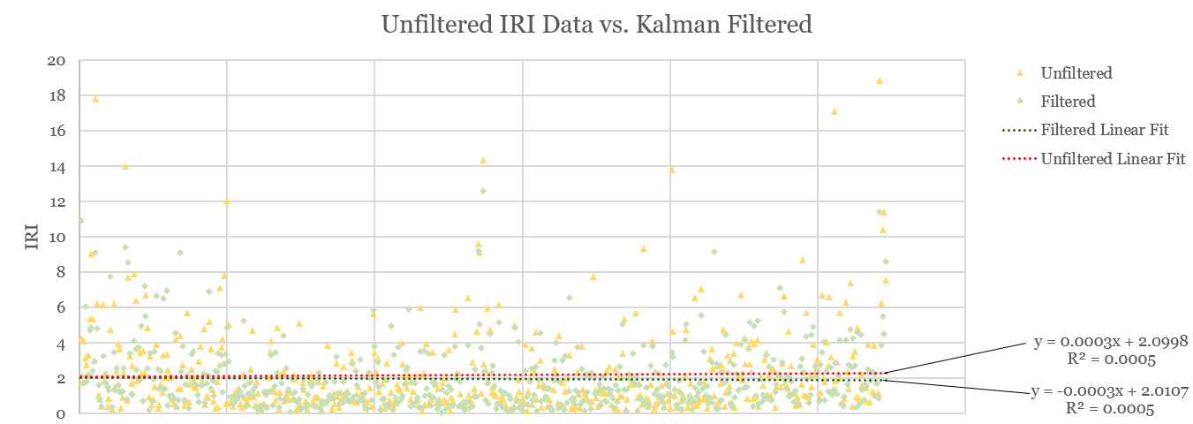
Test Results - Filtering

Slide 37
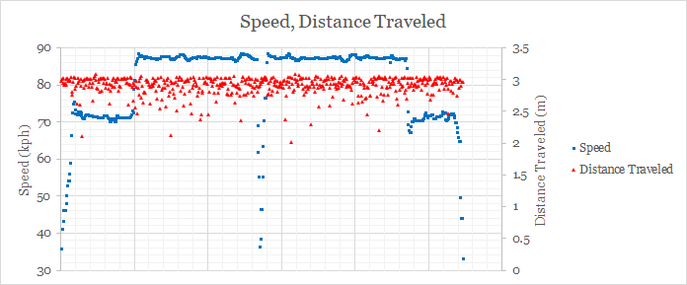
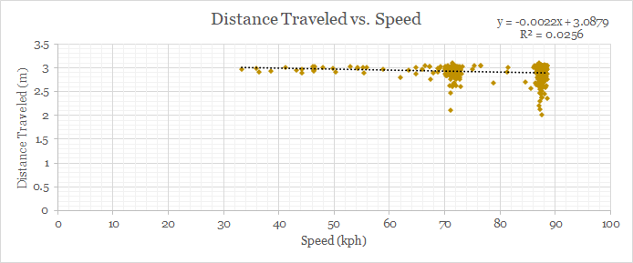
Test Results - Distance vs. Speed for Sample

Slide 38
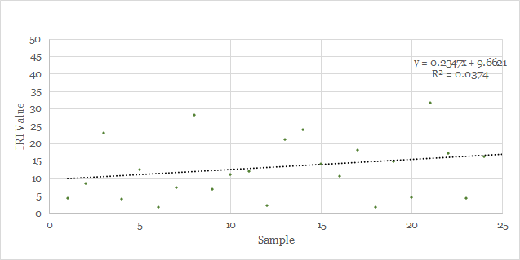
Test Results - Unpaved Road ~55kph

Slide 39
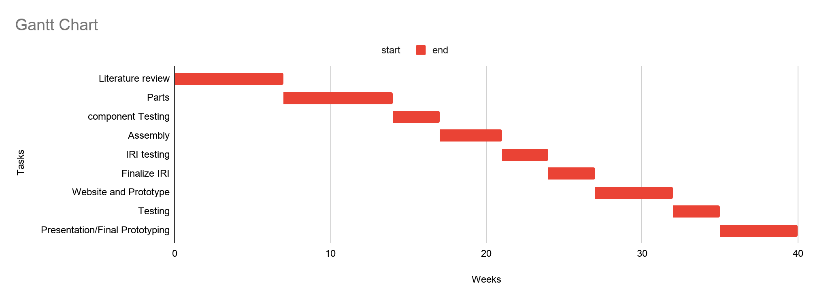
Timeline

